Slide 1

Smart Attendance Management System:
An Innovative Existing Solution
December 7, 2023

Slide 2

Team
December 7, 2023

Slide 3
Common Challenges with Traditional Attendance Mechanisms
Manual recording
Traditional attendance mechanisms require manual recording of attendance, which is time-consuming and prone to errors.
Inaccurate data
Manual recording often leads to inaccurate data due to human error, resulting in incorrect attendance records.
Lack of verification
Traditional attendance mechanisms lack verification methods, making it difficult to ensure the authenticity of attendance entries.

Slide 4
Introduction to Attendance Management System
1
2
3
Comprehensive web application for managing student attendance
Includes user-friendly interface and robust backend technology
Aims to simplify and streamline the process of managing and analyzing student attendance data

Slide 5
Leveraging Computer Vision Techniques
1
1
2
2
3
3
The Attendance Management System leverages Python's OpenCV library for computer vision techniques.
The integration of computer vision techniques ensures genuine entries and reduces manual labor and errors.
Prebuilt models are used to enhance the system's accuracy in recognizing faces.

Slide 6
Core Functionalities
The system tracks and manages student attendance, with the ability to record and analyze attendance trends over time.
It utilizes Firebase Realtime Database for real-time data processing and scalability.
1
4
It maintains a database of student information, including names, majors, academic standing, and other details.
The system allows user interaction and has editing capabilities for managing student records.
2
5
The application uses a web interface, ensuring accessibility for administrators, teachers, and students.
It implements session-based authentication and email-based OTP verification for security.
3
6

Slide 7
Role of Python's OpenCV Library
Benefits
Integration with Prebuilt Models
Automates the process of recording attendance
Leverages computer vision techniques
Improves accuracy
Reduces manual labor and errors
Utilizes prebuilt models for face recognition
Ensures genuine entries with high accuracy
Provides real-time monitoring

Slide 8
Reducing Manual Labor and Errors
Enhanced Accuracy
The Attendance Management System utilizes computer vision techniques and prebuilt models to accurately recognize faces and record attendance, reducing errors caused by manual entry.
Automation
By automating the process of recording attendance, the system eliminates the need for manual data entry, saving time and reducing labor-intensive tasks.
Efficiency
The system streamlines the attendance management process, reducing the possibility of errors and ensuring a more efficient and effective way of recording attendance.

Slide 9
Web-Based Interface and Firebase Integration
Web-Based Interface
Firebase Integration
The system is accessible through a web browser, ensuring convenience and accessibility for users.
Administrators, teachers, and students can interact with the system via the web interface.
The system is accessible through a web browser, ensuring convenience and accessibility for users.
Administrators, and students can interact with the system via the web interface.

Slide 10
User Interaction and Editing Capability
Key Points
The system allows quick and easy updates to student records without navigating away from the main interface.
Modal forms are used for editing attendance data for each student, enhancing user experience.
The interface is designed to be user-friendly, allowing seamless interaction for administrators, and students.
The system ensures data accuracy and integrity through robust data validation and error handling.

Slide 11
Security Measures: Session-Based Authentication and OTP Verification
Session-Based Authentication is implemented to emphasize on security and user session management.
The use of Email-Based OTP Verification adds an extra layer of security, crucial for protecting sensitive student data.
Firebase Realtime Database ensures secure real-time data processing with built-in authentication and security rules.
The system prioritizes data security by adopting multiple layers of user verification and authentication.

Slide 12
Technology Stack
Frontend
Backend
Database
The frontend utilizes HTML, CSS, and JavaScript. Bootstrap is used for modals and styling, and JavaScript handles asynchronous data and dynamic content updates.
The backend is built on Flask, a Python web framework known for its lightweight and flexible architecture, suitable for real-time data handling and cloud-based storage.
FaceRecognition Prebuild Module for face detection
The system uses Firebase Realtime Database, offering real-time data processing, scalability for large student records, and additional functionalities like authentication and cloud storage.

Slide 13
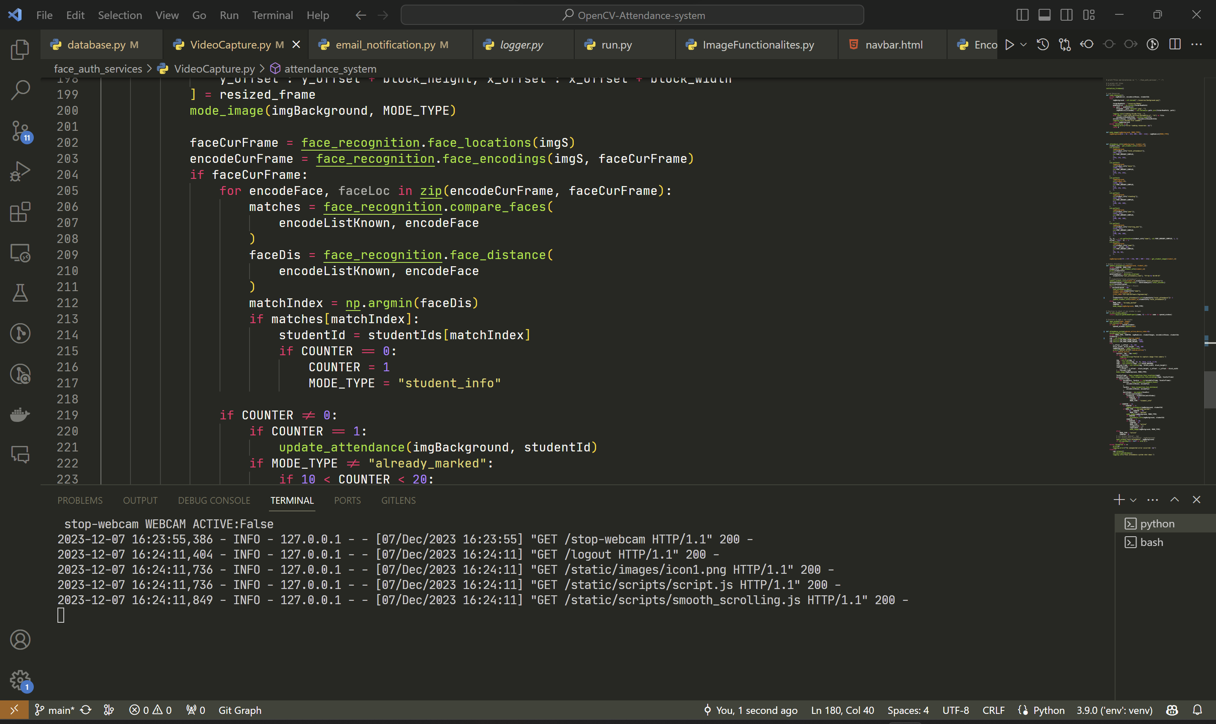

Slide 14
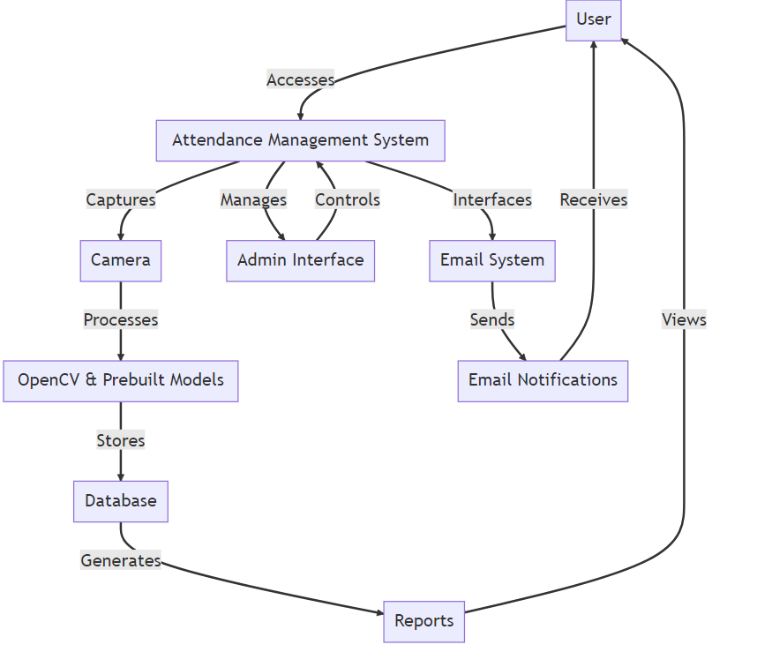




Your logo
Project Flow

Slide 15
Potential Use Cases
Educational institutions can utilize the system for tracking daily student attendance and managing records.
Administrative staff have the capability to monitor student engagement and participation.
Students, with the appropriate permissions, can view their attendance records for self-assessment and record-keeping.

Slide 16
Future Development Scope
Advanced Analytics
Extended Functionality
Incorporating more detailed analytics on student attendance, such as identifying patterns and trends, and providing actionable insights for the institution.
Utilizing data on student absence and attendance to implement automated absence alerts for both students and teachers.
Integrating the system with other educational tools, such as Learning Management Systems or student notification platforms.
Developing a mobile app version for the system, allowing for easier access and on-the-go functionality for both students and teachers.

Slide 17

Summary
The system focuses on attendance tracking and student data management.
It uses a web-based interface and integrates with Firebase for real-time data processing.
The application emphasizes user interaction and editing capability, while prioritizing security with session-based authentication and OTP verification.
Key Points

Slide 18

Question & Answer
Questions
How does the system handle data security, especially in terms of student privacy?
What are the potential challenges in implementing more detailed analytics on student attendance?
How does the web-based interface impact the accessibility of the system for users, particularly in remote learning scenarios?

Slide 19
Thank you!

